Slide 1

Credit Score
Classification
Supervised by :
Dr. Doaa Mahmoud & Eng. Shaimaa
Notebook
SIC 5
Notes:
Note:

Slide 2

Agenda
Problem Statement
Business Plan
EDA
EDA
Modelling and Evaluation
Business Solution and Future Work

Slide 3

01
Problem Statement
The problem that banks suffer from , and this data can solve them
Notes:
Note:

Slide 4

Preventing Loan Defaults: Key Strategies for Lenders
Lenders are in a challenging position. How can they prevent and avoid loan delinquency, especially when it comes to rising first-time defaulters? What can they do to better mitigate loan default risks?

Slide 5
02
Business Plan
what will be achieved at the end
Notes:
Note:

Slide 6
Our business plan :
Customer Behavior: Borrower behavior, such as early repayments or taking on additional debt, can affect risk profiles and require constant monitoring
Developing and maintaining effective credit scoring model that accurately predict default risk is an ongoing challenge

Slide 7
03
Data Prepressing
Data Handling

Slide 8
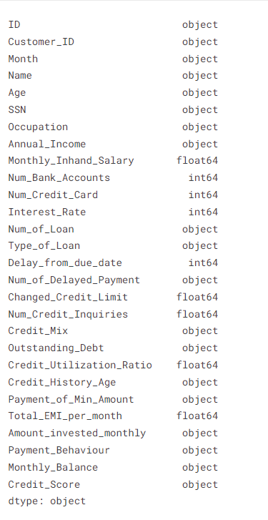
Credit Score Classification **** Data Preparation ****
Most of the data features are objects

Slide 9
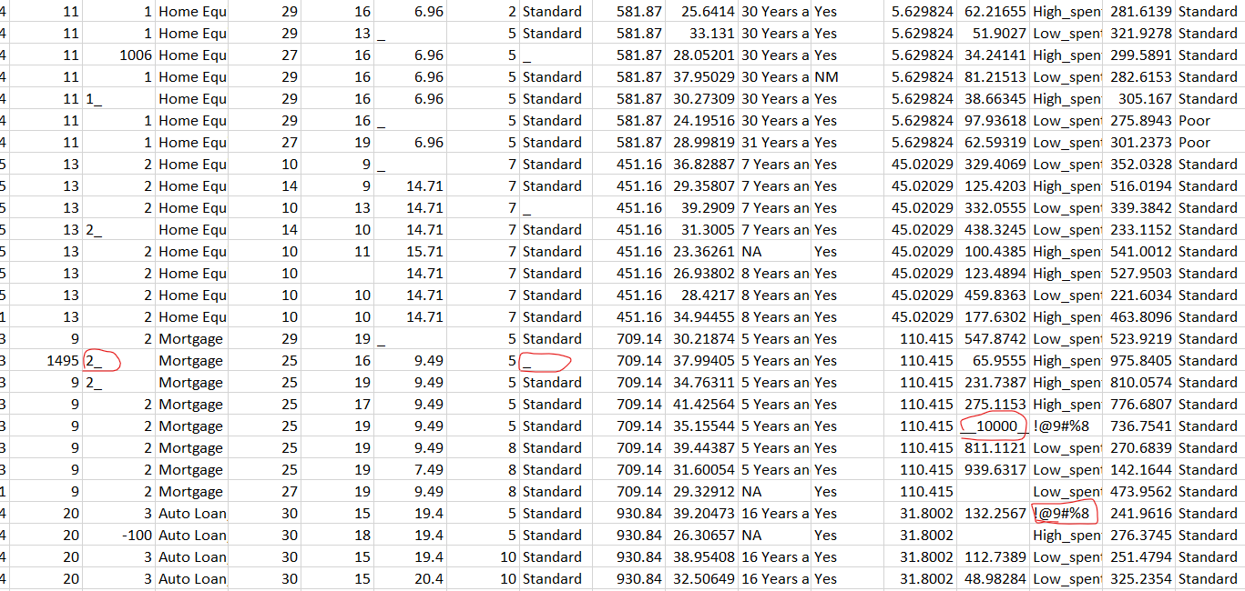
Credit Score Classification **** Data Preparation ****
Dataset contains wrong values such as: ‘_’, ‘_____’, ‘!@9#%8’, ‘#F%$D@*&8’, and ‘nan’
We removed it either by recognizing it in the reading of the dataset converting it to Null value or by extracting the digits from the value.

Slide 10
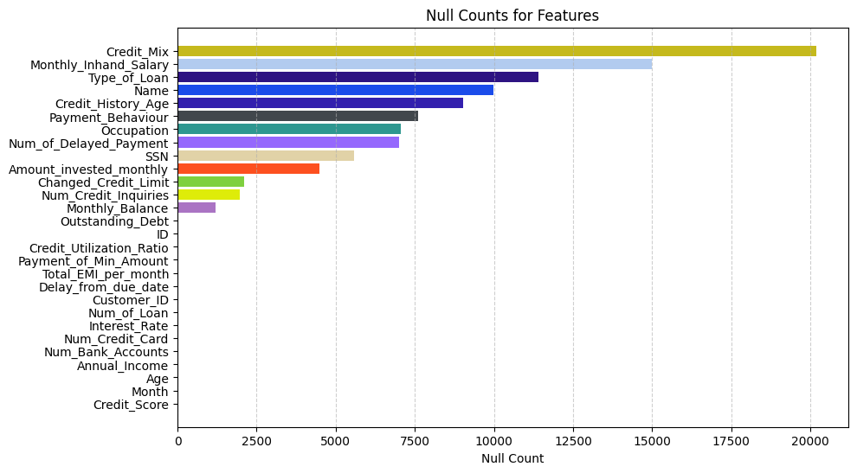
Credit Score Classification **** Data Preparation ****
After the removal of the wrong data values, this is the null data
We could benefit from Customer ID to fill the Null data

Slide 11
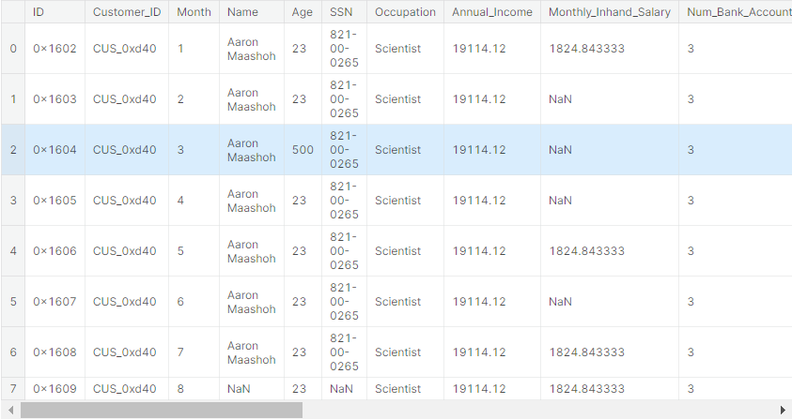
Credit Score Classification **** Data Preparation ****
Use the customer ID to fill the Name, SSN, Credit Mix, Monthly In hand salary, and Occupation Features

Slide 12
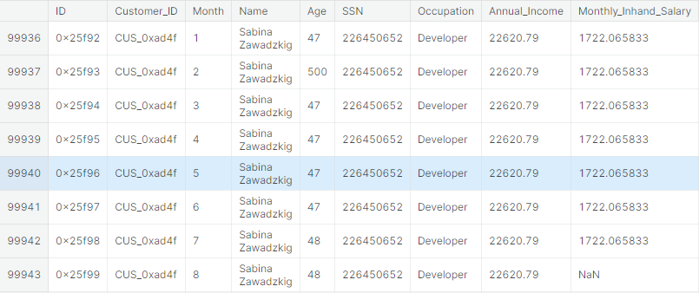
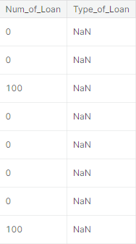
Credit Score Classification **** Data Preparation ****
For the Type of loan, the whole values according to Customer ID are Nulls.
The thing is the number of loans is either 0 or 100 wrong values(unrealistic)
We fill it with NA

Slide 13
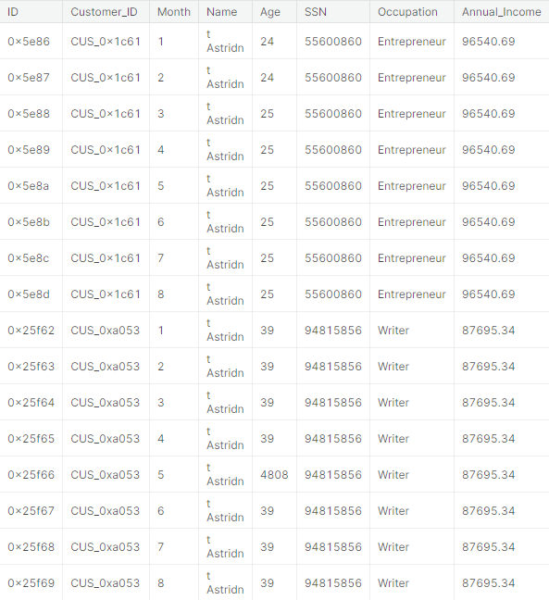
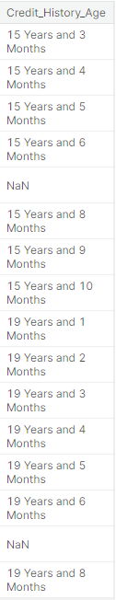
Credit Score Classification **** Data Preparation ****
For the Credit History Age, Changed Credit Limit, Num Credit Inquiries, Credit Mix, Num of Delayed Payment, Amount Invested Monthly, and Monthly balance, the whole Null values according to Customer ID are filled using interpolation.

Slide 14
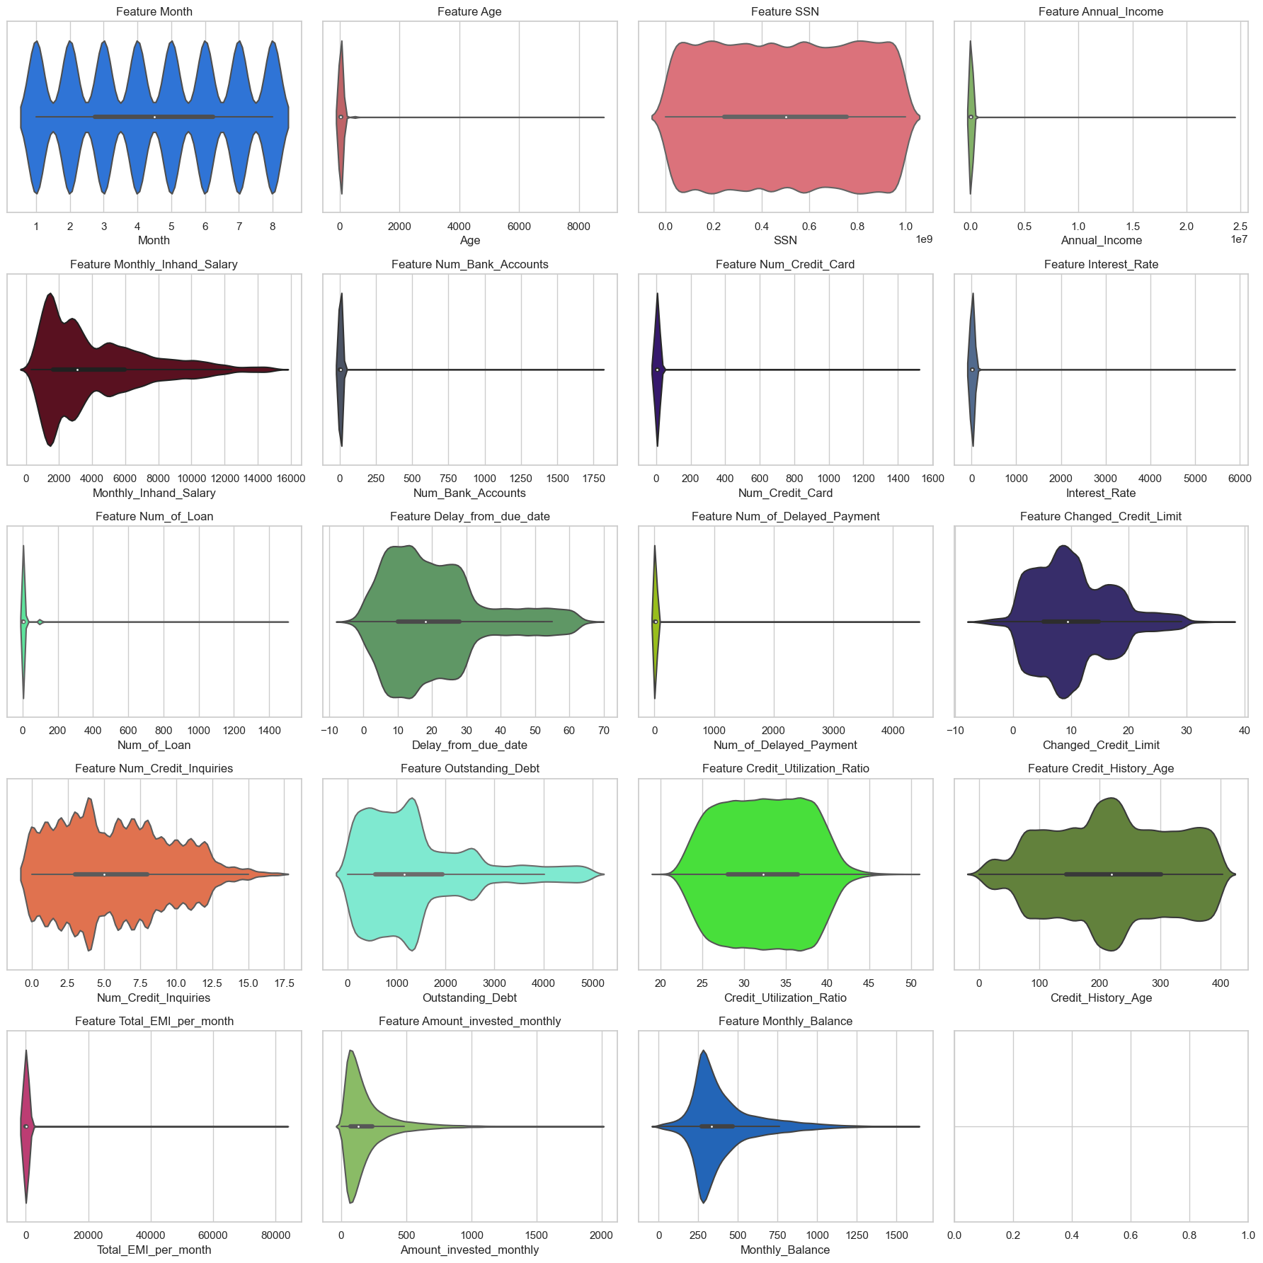
Credit Score Classification **** Data Preparation ****
Some of the data features are skewed and have unrealistic values.
We will remove it manually, applying real value according Customer ID

Slide 15
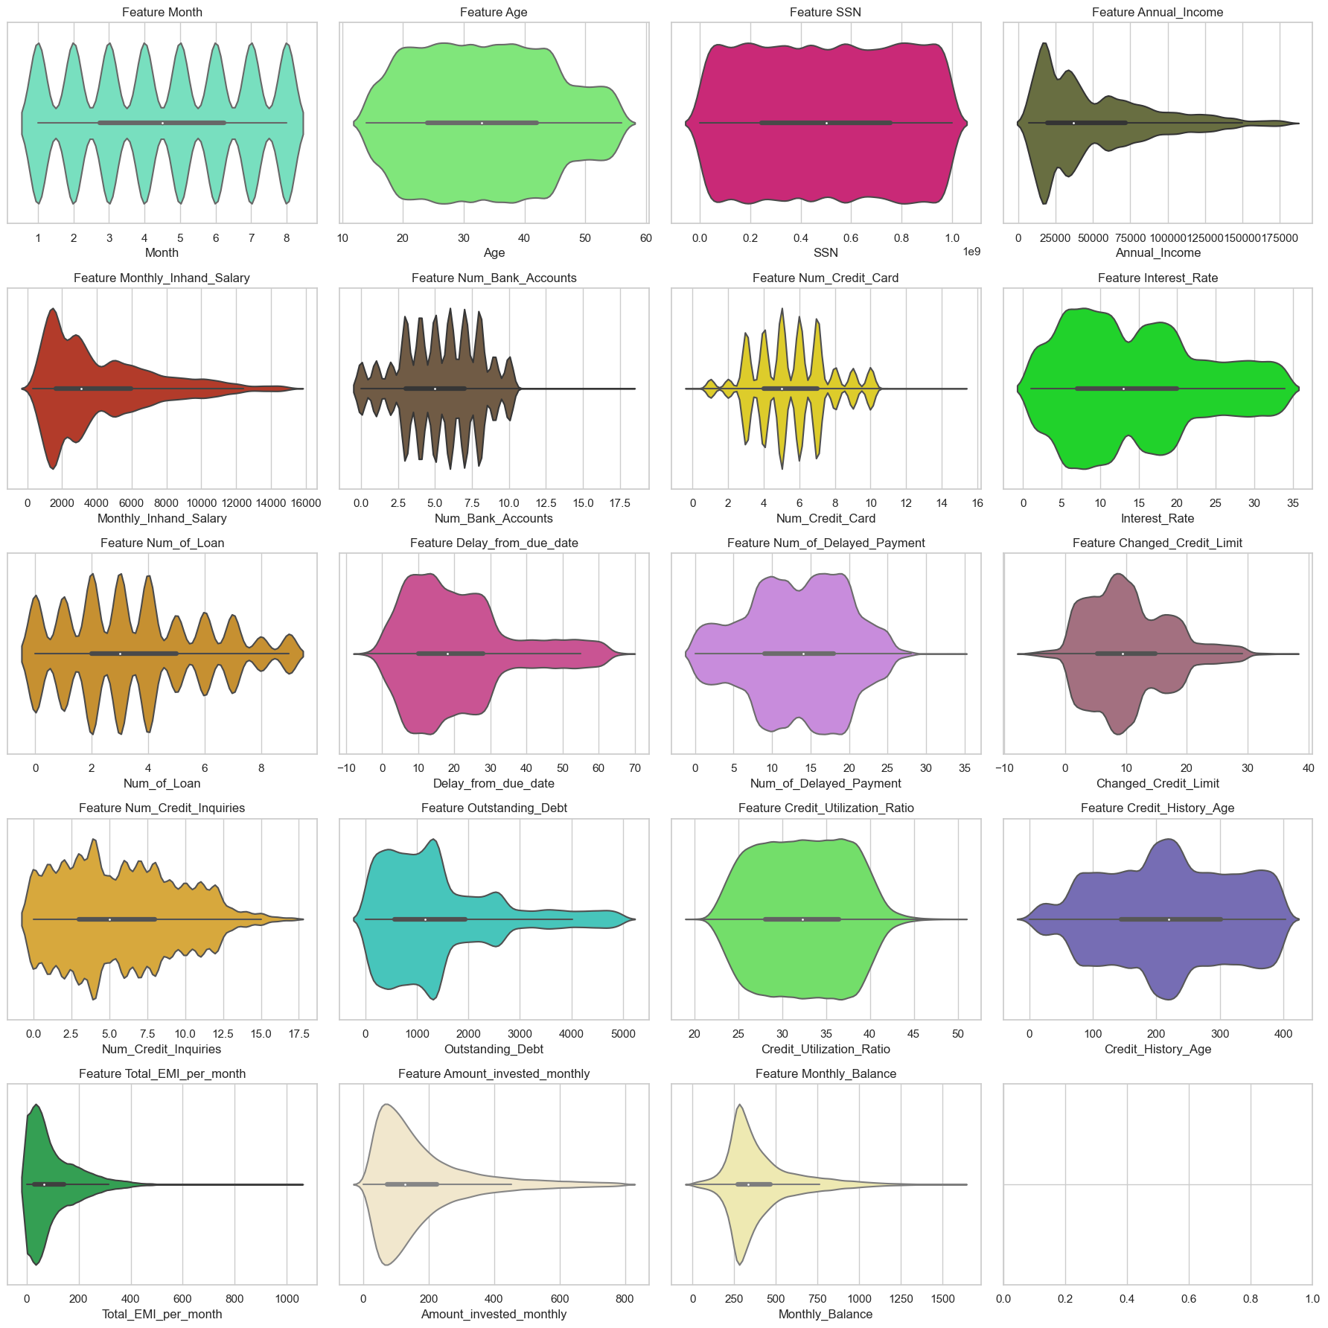
Credit Score Classification **** Data Preparation ****
After removing:

Slide 16
04
EDA
Exploratory Data Analysis
Notes:
Note:

Slide 17
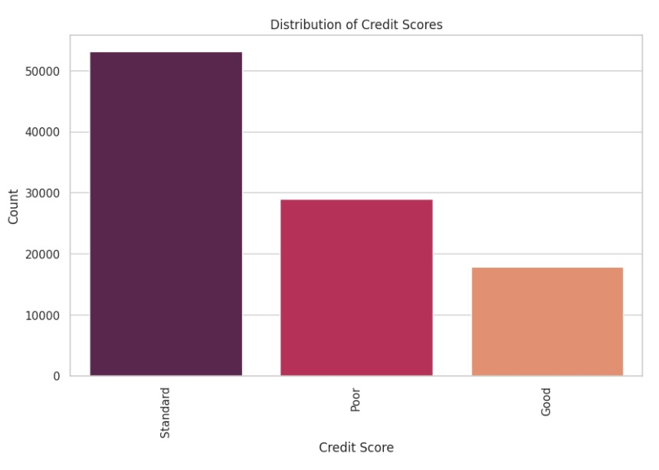
Credit Score Classification Visualization
Conclusion :
there are three statement for any loan
Impact:
This is our target that we will build our model on

Slide 18
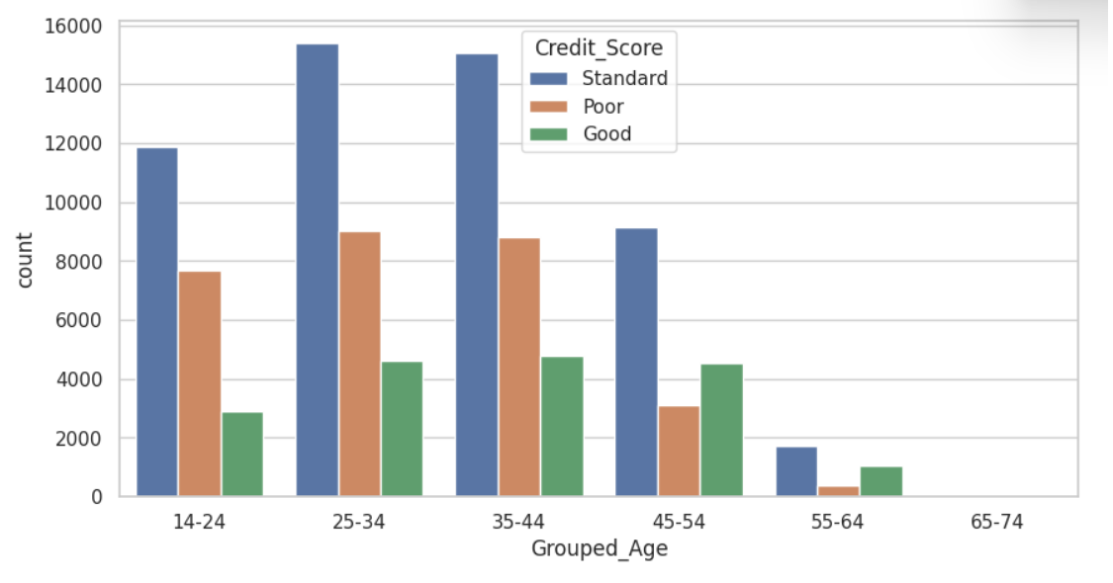
Credit Score Classification the effect of age on our 🎯
Conclusion :
the young people has risk statements more than older people
Impact:
This will help us determine if the person has a good chance to get a loan

Slide 19
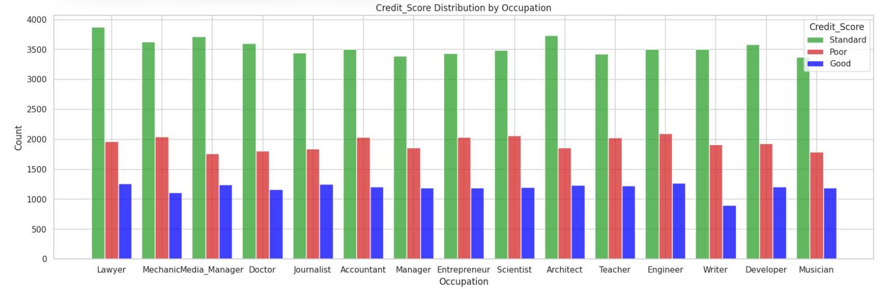
Credit Score Classification Does Occupation have a role
Conclusion :
some jobs have the chance to get the loan than others as writer as it is the lowest in poor credit score

Slide 20
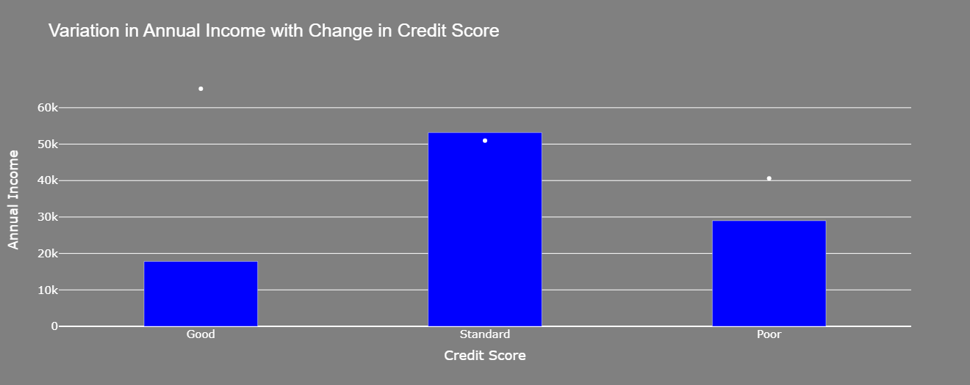
Credit Score Classification Annual income effect
Conclusion:
Most salaries over 30k are more stable as their credit score is standard

Slide 21
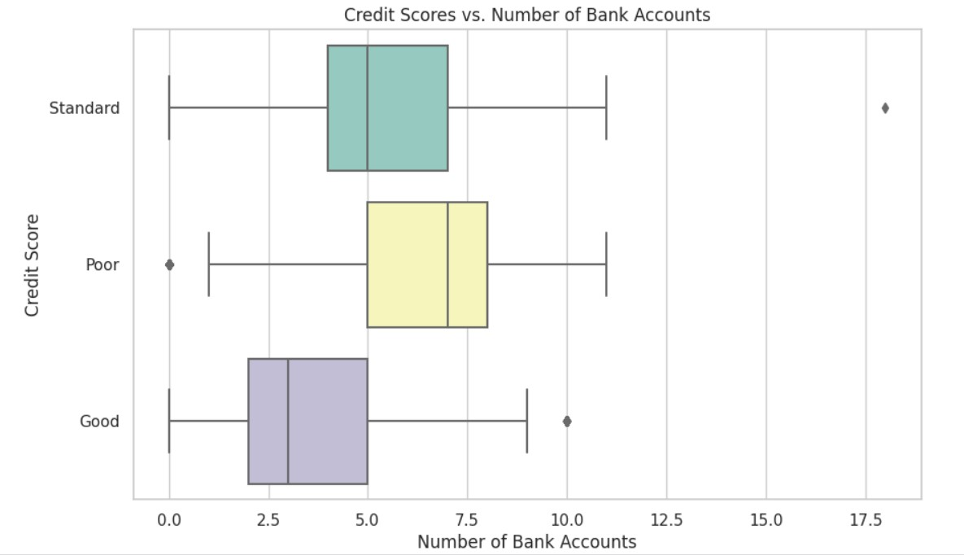
Credit Score Classification Does num of bank acc have any relation with the score
Conclusion :
The less of num of accounts the better in score

Slide 22
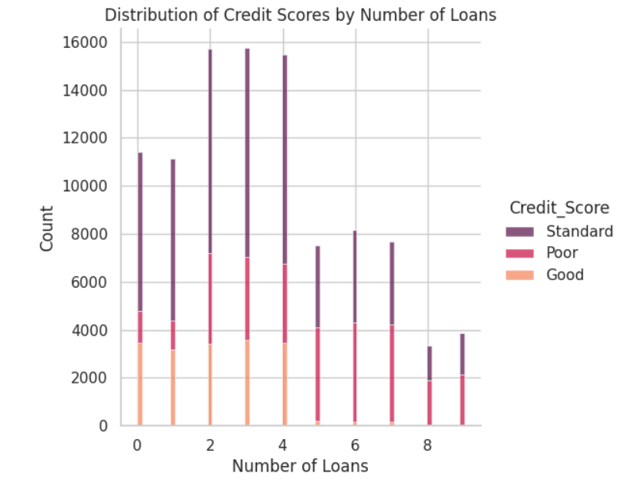
Credit Score Classification Distribution of Credit Scores by Number of Loans
Conclusion:
the less is better
Impact:
This help us to determine the condition of the person from number of loan

Slide 23
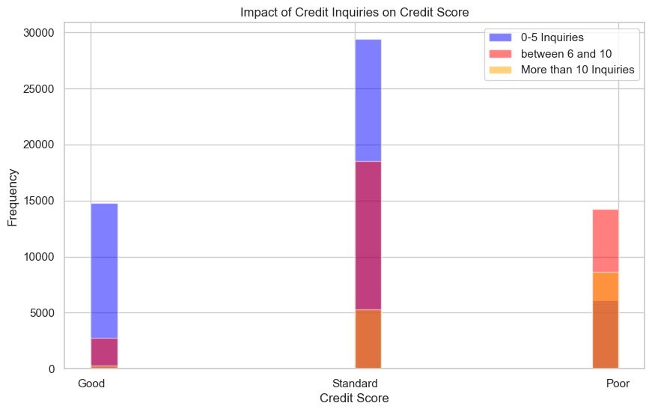
Credit Score Classification Impact of Credit Inquiries on Credit Score
Conclusion:
most of people who has poor score their credit inquiries is more than 10

Slide 24
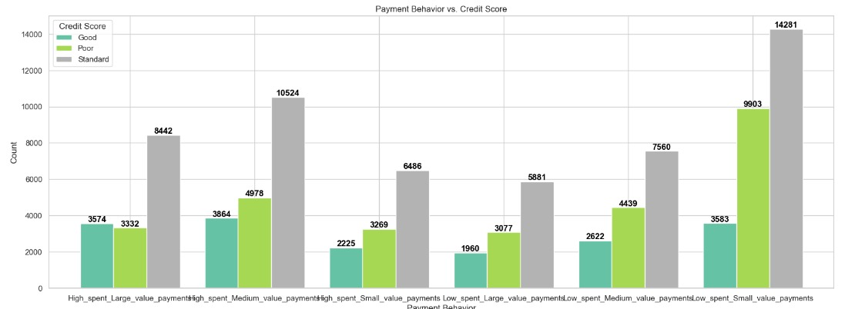
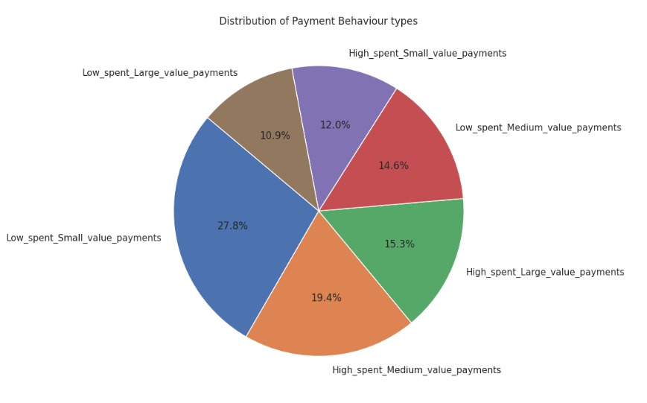
Credit Score Classification payment behavior impact
Impact:
This to not deal with a lot of this type of behaviors
Conclusion :
the most risky behavior is (low spent small value payment)

Slide 25
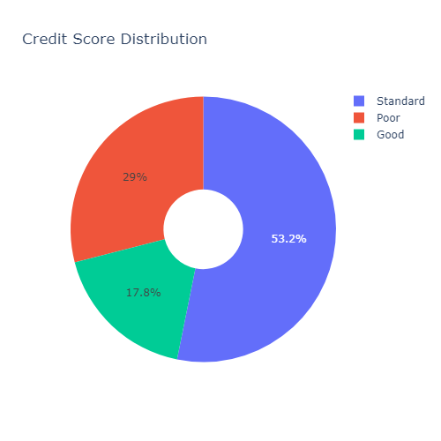
Credit Score Classification payment behavior impact
Observation: Imbalanced data.
We will Use SMOTE for Oversampling

Slide 26

Credit Score Classification 05 Data Preparation
For Encoding we used label and leave one out encoders.

Slide 27
05
Modeling and evaluation
Applying some models in machine learning
Notes:
Note:

Slide 28
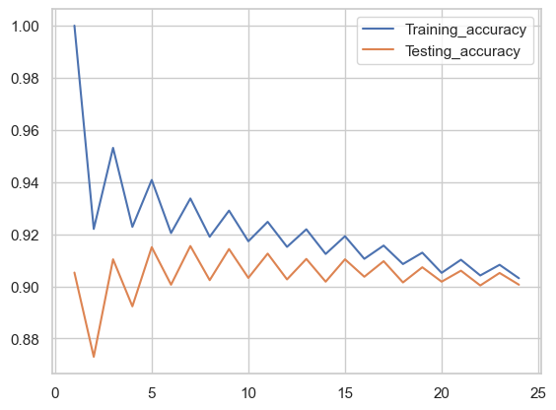
Credit Score Classification 04 Modelling and Evaluation
KNN Classifier
N-neighbors=26

Slide 29
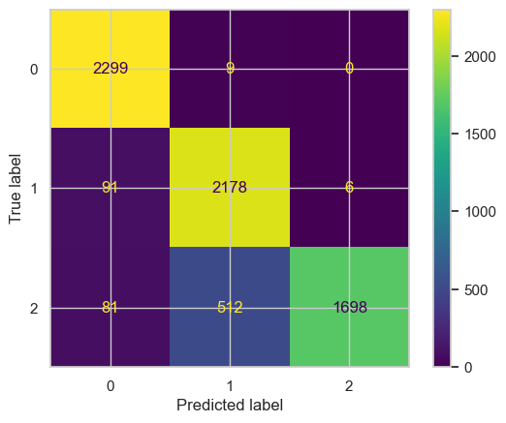
Credit Score Classification 04 Modelling and Evaluation
KNN Classifier
 | Precision | Recall | F1-score | Support
Good(0) | 0.93 | 1.00 | 0.96 | 2308
Poor(1) | 0.81 | 0.96 | 0.88 | 2275
Standard(2) | 1.00 | 0.74 | 0.85 | 2291
Macro Avg | 0.91 | 0.90 | 0.90 | 6874
Weighted Avg | 0.91 | 0.90 | 0.90 | 6874
Train Accuracy | 0.9017
Test Accuracy | 0.8983

Slide 30
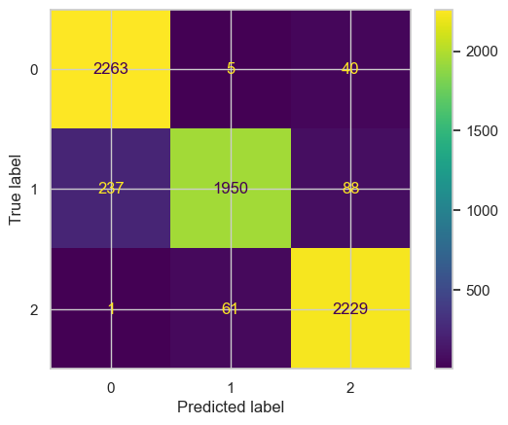
Credit Score Classification 04 Modelling and Evaluation
Ridge Classifier
 | Precision | Recall | F1-score | Support
Good(0) | 0.90 | 0.98 | 0.94 | 2308
Poor(1) | 0.97 | 0.86 | 0.91 | 2275
Standard(2) | 0.95 | 0.97 | 0.96 | 2291
Macro Avg | 0.94 | 0.94 | 0.94 | 6874
Weighted Avg | 0.94 | 0.94 | 0.94 | 6874
Train Accuracy | 0.9352
Test Accuracy | 0.9371

Slide 31
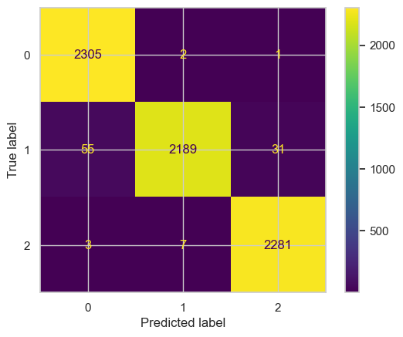
Credit Score Classification 04 Modelling and Evaluation
Linear SVC
 | Precision | Recall | F1-score | Support
Good(0) | 0.98 | 1.00 | 0.99 | 2308
Poor(1) | 1.00 | 0.96 | 0.98 | 2275
Standard(2) | 0.99 | 1.00 | 0.99 | 2291
Macro Avg | 0.99 | 0.99 | 0.99 | 6874
Weighted Avg | 0.99 | 0.99 | 0.99 | 6874
Train Accuracy | 0.9841
Test Accuracy | 0.9855

Slide 32
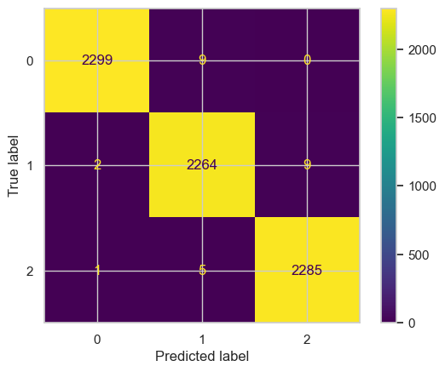
Credit Score Classification 04 Modelling and Evaluation
Logistic Regression
 | Precision | Recall | F1-score | Support
Good(0) | 0.99 | 0.99 | 0.99 | 2308
Poor(1) | 0.99 | 0.98 | 0.99 | 2275
Standard(2) | 1.00 | 1.00 | 0.98 | 2291
Macro Avg | 0.99 | 0.99 | 0.99 | 6874
Weighted Avg | 0.99 | 0.99 | 0.99 | 6874
Train Accuracy | 0.99392
Test Accuracy | 0.99395

Slide 33

Credit Score Classification 04 Modelling and Evaluation
SVC Classifier
 | Precision | Recall | F1-score | Support
Good(0) | 1.00 | 1.00 | 1.00 | 2308
Poor(1) | 0.99 | 1.00 | 1.00 | 2275
Standard(2) | 1.00 | 1.00 | 1.00 | 2291
Macro Avg | 1.00 | 1.00 | 1.00 | 6874
Weighted Avg | 1.00 | 1.00 | 1.00 | 6874
Train Accuracy | 0.99788
Test Accuracy | 0.99718

Slide 34

Credit Score Classification 04 Modelling and Evaluation
Gradient Boosting Classifier
 | Precision | Recall | F1-score | Support
Good(0) | 1.00 | 1.00 | 1.00 | 2308
Poor(1) | 1.00 | 1.00 | 1.00 | 2275
Standard(2) | 1.00 | 1.00 | 1.00 | 2291
Macro Avg | 1.00 | 1.00 | 1.00 | 6874
Weighted Avg | 1.00 | 1.00 | 1.00 | 6874
Train Accuracy | 0.99987
Test Accuracy | 0.99982

Slide 35
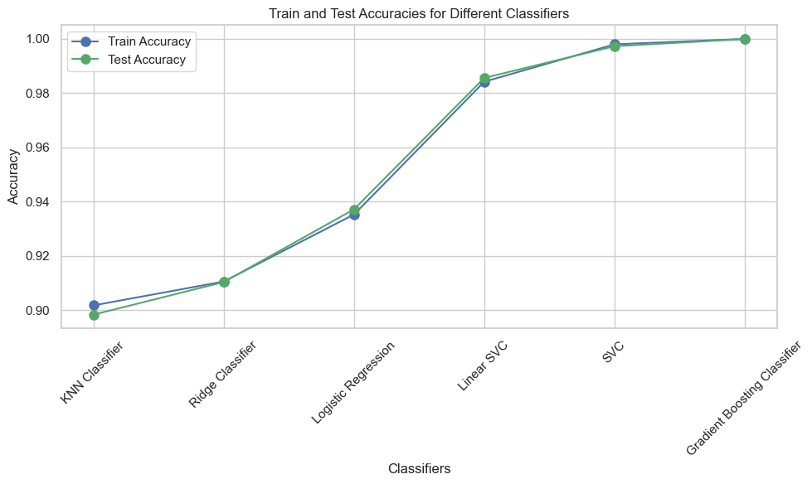
Credit Score Classification 04 Modelling and Evaluation
Gradient Boosting Classifier is the best

Slide 36
Any question
We hope everyone enjoys and takes advantage of the presentation

